Slide 1
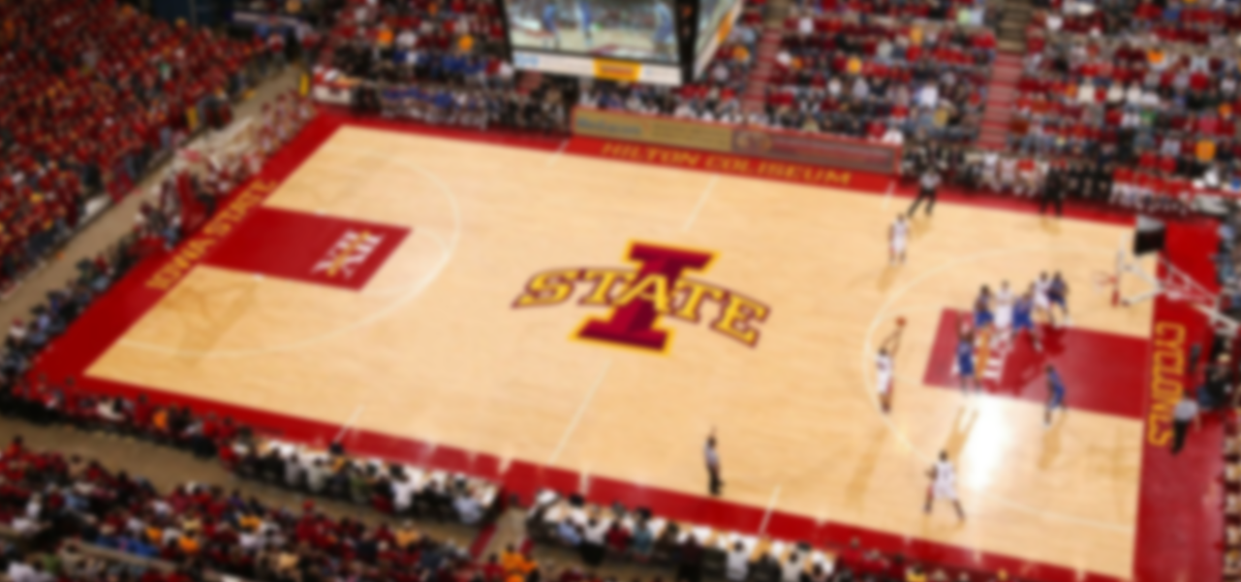
Web Tournaments
GROUP 7

Slide 2

The Team
Michael Davis
SE, WebFilings Intern
Max Peterson
SE, WebFilings Intern
Robert Sheehy
SE, WebFilings Intern
Mark Gollnick
CPrE, WebFilings Intern
Taehyun Park
CPrE, ITS Mobile App Developer
Notes:
Introduce team members. Each member introduce brifely themselves

Slide 3
Contents
1. Web Tournaments
2. Application Analysis
3. Development Process
4. Application Demonstration
`
Notes:
We’ve got four big pictures of our web application, web tournaments. 1. Overview of Web Tournaments, 2. Usability Features we are going to check more of

Slide 4

WEB TOURNAMENTS
Notes:
Move to the next slide after 3 seconds

Slide 5
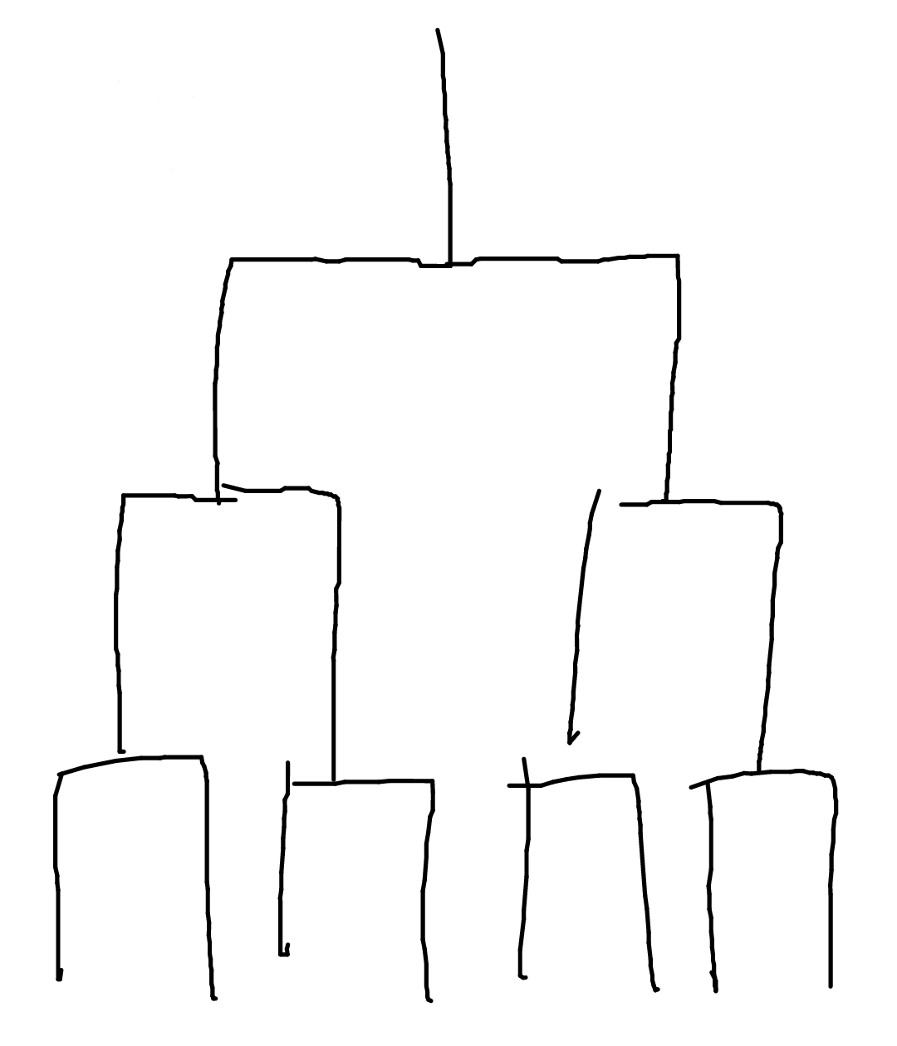
Problem Statement
Notes:
Quickly drawing brackets and determining seeds by hand is tedious and time consuming. There are currently no applications that will allow a user to quickly and easily set up a bracket without having to deal with some aspect of setup manually. Our application does this job.

Slide 6
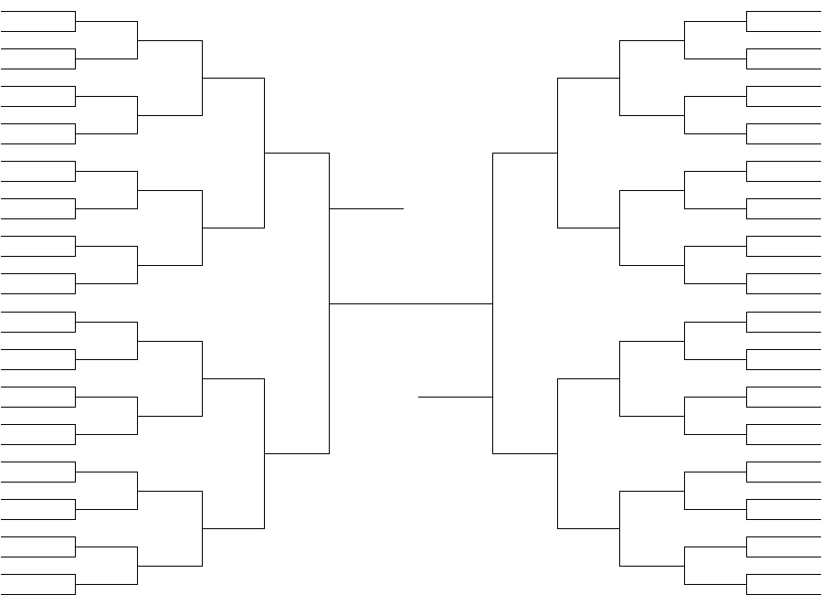
Problem Statement
Notes:
Quickly drawing brackets and determining seeds by hand is tedious and time consuming. There are currently no applications that will allow a user to quickly and easily set up a bracket without having to deal with some aspect of setup manually. Our application does this job.

Slide 7


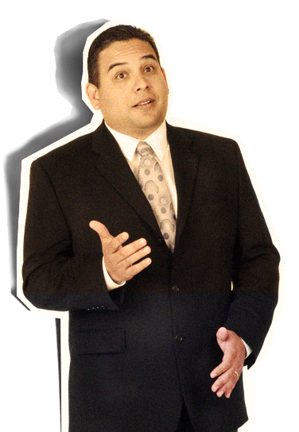
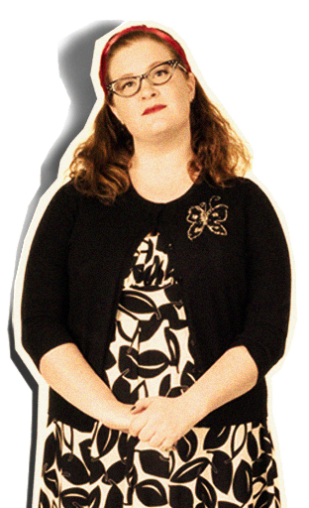
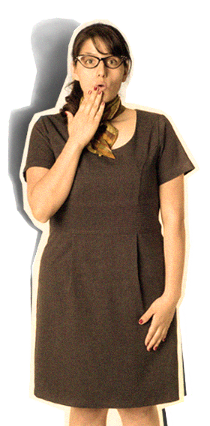
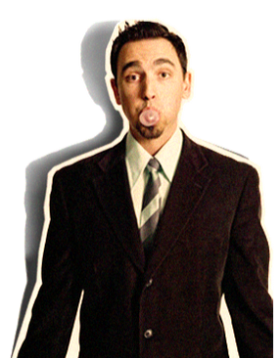
Target Audience
Easy to use
COOL
So
Notes:
The target audience for our app is everyone who wants to set up their own tournament can be users. Here everyone, including non tech people

Slide 8
Usability Features
Tournaments
Create, edit, delete tournaments
Decide tournament rules
Determine match winner
Administer tournament permissions
View tournaments in progress

Slide 9
Usability Features
Users
Account creation
Account login
Account edit
Create groups for easy tournament creation

Slide 10



2
APPLICATION
ANALYSIS
Notes:
Move to the next slide after 2 seconds

Slide 11

Platform
Google AppEngine
Easy
Affordable
Scaleable
Notes:
Cloud environment for running Python, Java, and Go based web applications

Slide 12





Languages / Frameworks
Python
Flask
A lightweight Python web framework
AppEngine Datastore
Delicious NoSQL database
jQuery
Making JavaScript not horrible since 2006
SVC / HTML5 Canvas
Displaying tournament bracket

Slide 13
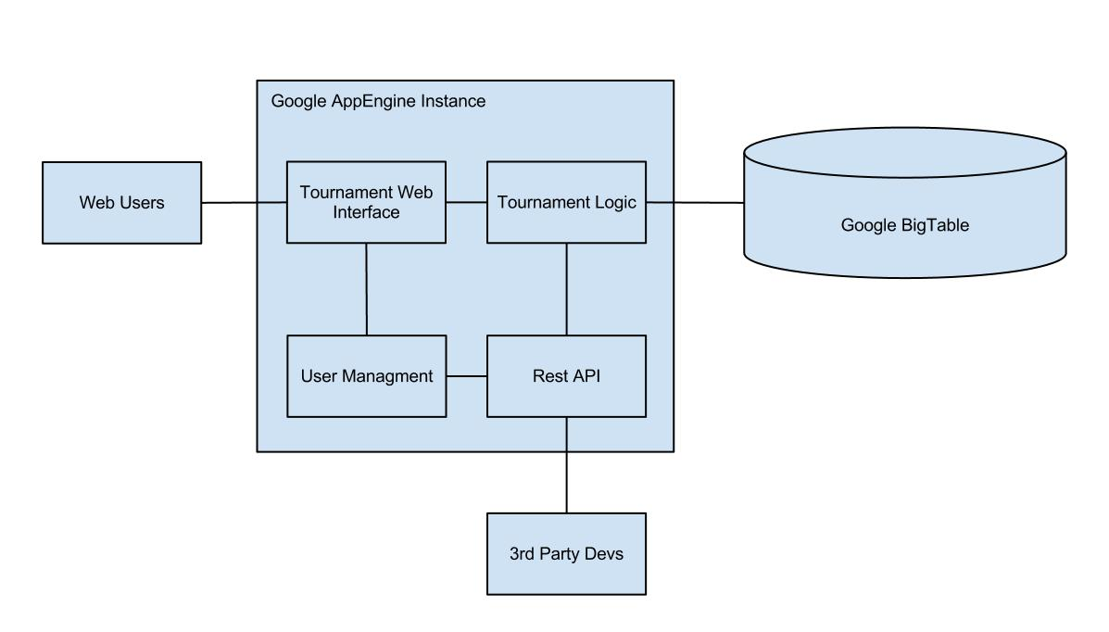

Architectural View

Slide 14


Collaboration
Github
Easy code reviews on pull requests
Easy branching for keeping code organized
Maintainable after semester ends
Stashing is invaluable when making quick changes
Trello
Easy code reviews on pull requests

Slide 15
Github
Trello
Easy code reviews on pull requests
Easy branching for keeping code organized
Maintainable after semester ends
Stashing is invaluable when making quick changes
Trello
Easy code reviews on pull requests

Slide 16
Trello
Trello
Easy code reviews on pull requests
Easy branching for keeping code organized
Maintainable after semester ends
Stashing is invaluable when making quick changes
Trello
Easy code reviews on pull requests

Slide 17

3
DEVELOPMENT
PROCESS
Notes:
Since we have mentioned the user interface, let’s take a look at our application.
Move to the next slide after 3 seconds

Slide 18
Responsibilities of Members
User authentication and management
Michael Davis
Tournament Logic / Model Scheme
Taehyun Park, Mark Gollnick
Tournament Web Interface
Robert Sheehy, Maxwell Peterson

Slide 19
Timeline
OCT
Basic user creation and authentication
Database design finalized
Basic tournaments running
Web interfaces mocked up and working
Advanced tournaments running
REST API
Notes:
Current
Basic user creation and authentication
Mid-October
Database design finalized
Basic tournaments running
Web interfaces mocked up and working
End of October
Advanced tournaments running
Sharing tournaments with friends (Facebook/Twitter)

Slide 20
NOV
Sharing tournaments with friends (Facebook)
Polished user interfaces
Beta testing and fixes
Betting odds calculator
DEC
1.0 Release
Continued support
Feature requests
Notes:
Mid-November
Polished user interfaces
Beta testing and fixes
Betting odds calculator
End of November
1.0 Release
Future
Continued support
Feature requests

Slide 21
Challenges
User authentication and management
Michael Davis
Tournament Logic / Model Scheme
Taehyun Park, Mark Gollnick
Tournament Web Interface
Robert Sheehy, Maxwell Peterson

Slide 22










APPLICATION
4
5 MINS
DEMO
Notes:
Move to the next slide after 4 seconds

Slide 23
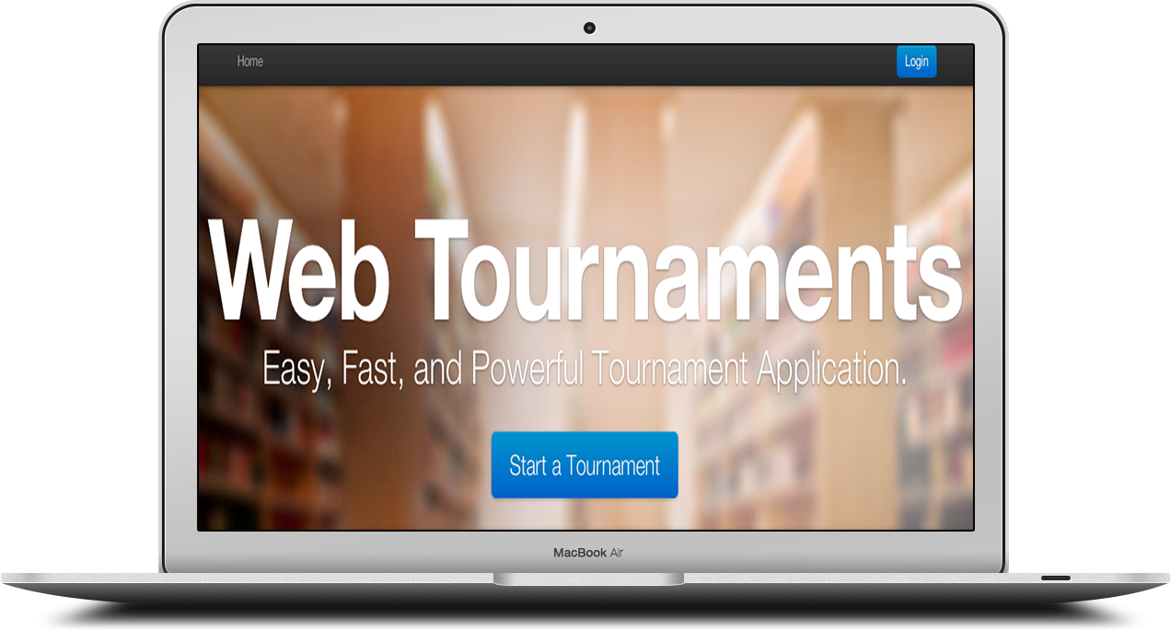
Demonstration

Slide 24
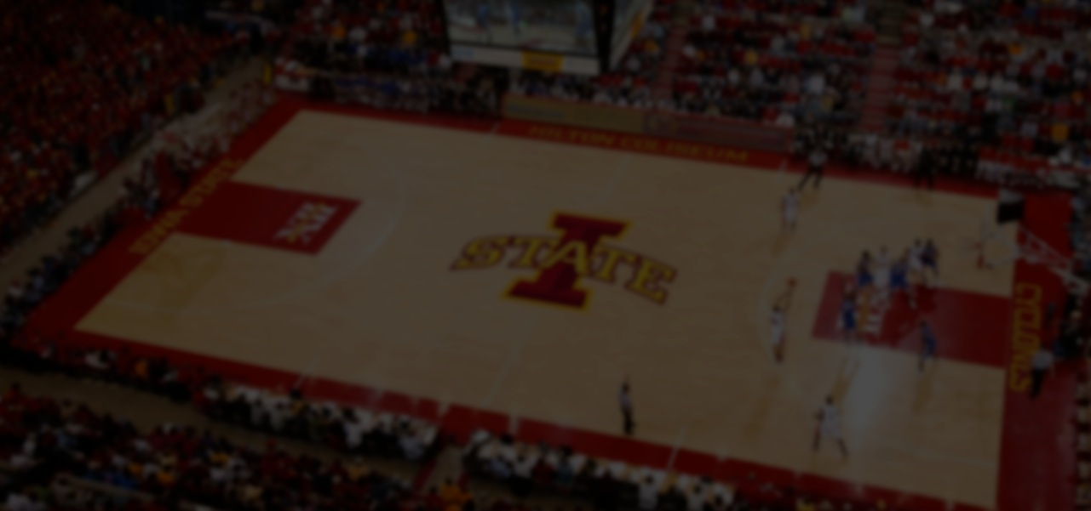
QUESTIONS?

Slide 25
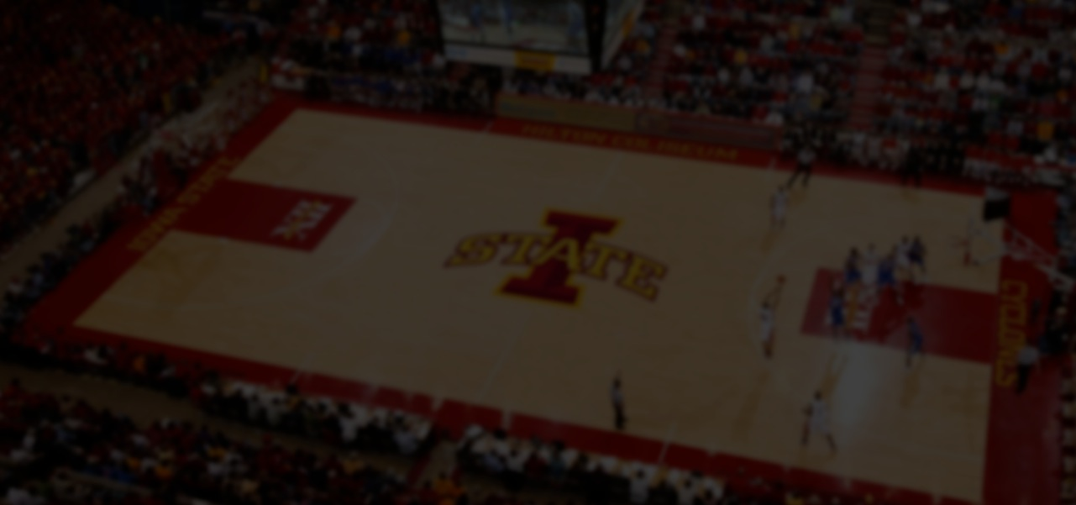
THANK YOU

